Slide 1
Dataflow Modeling

Slide 2
DATAFLOW MODELING - LEARNING OBJECTIVES
Describe the continuous assignment (assign) statement, restrictions on the assign statement, and the implicit continuous assignment statement
Explain assignment delay, implicit assignment delay, and net declaration delay for continuous assignment statements
Define expressions, operators, and operands
List operator types for all possible operations Arithmetic, logical, relational, equality, bitwise, reduction, shift, concatenation, and conditional
Use dataflow constructs to model practical digital circuits in Verilog

Slide 3
DATAFLOW MODELING - INTRODUCTION
For small circuits, the gate-level modeling approach works very well because the number of gates is limited and the designer can instantiate and connect every gate individually
Also, gate-level modeling is very intuitive to a designer with a basic knowledge of digital logic design
However, in complex designs the number of gates is very large. Thus, designers can design more effectively if they concentrate on implementing the function at a level of abstraction higher than gate level
Dataflow modeling provides a powerful way to implement a design
Verilog allows a circuit to be designed in terms of the data flow between registers and how a design processes data rather than instantiation of individual gates

Slide 4
DATAFLOW MODELING – INTRODUCTION –Cont’d
With gate densities on chips increasing rapidly, dataflow modeling has assumed great importance
No longer can companies devote engineering resources to handcrafting entire designs with gates
Currently, automated tools are used to create a gate-level circuit from a dataflow design description
This process is called logic synthesis
Dataflow modeling has become a popular design approach as logic synthesis tools have become sophisticated
This approach allows the designer to concentrate on optimizing the circuit in terms of data flow
For maximum flexibility in the design process, designers typically use a Verilog description style that combines the concepts of gate-level, data flow, and behavioral design
In the digital design community, the term RTL (Register Transfer Level) design is commonly used for a combination of dataflow modeling and behavioral modeling

Slide 5
CONTINUOUS ASSIGNMENTS
A continuous assignment is the most basic statement in dataflow modeling, used to drive a value onto a net
This assignment replaces gates in the description of the circuit and describes the circuit at a higher level of abstraction
The assignment statement starts with the keyword assign
The syntax of an assign statement is as follows

Slide 6
CONTINUOUS ASSIGNMENTS - CHARACTERISTICS
The left hand side of an assignment must always be a scalar or vector net or a concatenation of scalar and vector nets. It cannot be a scalar or vector register.
Continuous assignments are always active. The assignment expression is evaluated as soon as one of the right-hand-side operands changes and the value is assigned to the left-hand-side net.
The operands on the right-hand side can be registers or nets or function calls. Registers or nets can be scalars or vectors.
Delay values can be specified for assignments in terms of time units.
Delay values are used to control the time when a net is assigned the evaluated value.
This feature is similar to specifying delays for gates. It is very useful in modeling timing behavior in real circuits.

Slide 7
DELAYS
Delay values control the time between the change in a right-hand-side operand and when the new value is assigned to the left-hand side
Three ways of specifying delays in continuous assignment statements are
Regular assignment delay
Implicit continuous assignment delay and
Net declaration delay

Slide 8
REGULAR ASSIGNMENT DELAY
The first method is to assign a delay value in a continuous assignment statement.
The delay value is specified after the keyword assign. Any change in values of in1 or in2 will result in a delay of 10 time units before recomputation of the expression in1 & in2, and the result will be assigned to out.
If in1 or in2 changes value again before 10 time units when the result propagates to out, the values of in1 and in2 at the time of recomputation are considered. This property is called inertial delay.
An input pulse that is shorter than the delay of the assignment statement does not propagate to the output.
assign #10 out = in1 & in2; // Delay in a continuous assign

Slide 9
REGULAR ASSIGNMENT DELAY –Cont’d
When signals in1 and in2 go high at time 20, out goes to a high 10 time units later (time = 30).
When in1 goes low at 60, out changes to low at 70.
However, in1 changes to high at 80, but it goes down to low before 10 time units have elapsed.
Hence, at the time of recomputation, 10 units after time 80, in1 is 0. Thus, out gets the value 0.
A pulse of width less than the specified assignment delay is not propagated to the output.

Slide 10
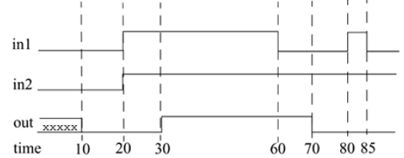
REGULAR ASSIGNMENT DELAY –Cont’d

Slide 11
IMPLICIT CONTINUOUS ASSIGNMENT DELAY
An equivalent method is to use an implicit continuous assignment to specify both a delay and an assignment on the net.
//implicit continuous assignment delay
wire #10 out = in1 & in2;
//same as
wire out;
assign #10 out = in1 & in2;
The declaration above has the same effect as defining a wire out and declaring a continuous assignment on out.

Slide 12
NET DECLARATION DELAY
A delay can be specified on a net when it is declared without putting a continuous assignment on the net.
If a delay is specified on a net out, then any value change applied to the net out is delayed accordingly.
Net declaration delays can also be used in gate-level modeling.
//Net Delays
wire # 10 out;
assign out = in1 & in2;
//The above statement has the same effect as the following.
wire out;
assign #10 out = in1 & in2;

Slide 13
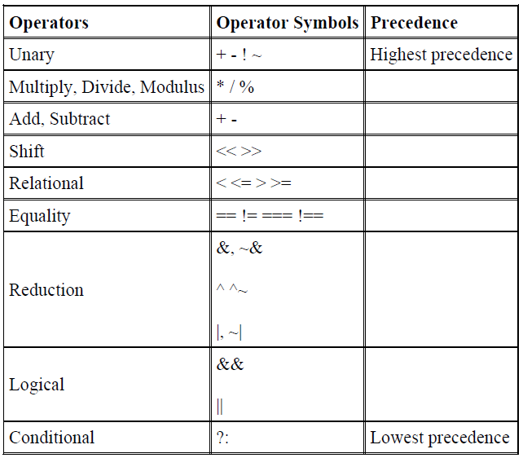
Operator Precedence

Slide 14
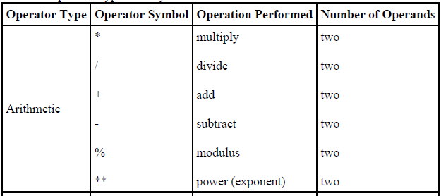
OPERATOR TYPES

Slide 15
Arithmetic Operators
There are two types of arithmetic operators: binary and unary.
Binary operators
Binary arithmetic operators are
multiply (*),
divide (/),
add (+),
subtract (-),
power (**),
and modulus (%).
Binary operators take two operands.
NOTE :
If any operand bit has a value x, then the result of the entire expression is x. This seems intuitive because if an operand value is not known precisely, the result should be an unknown.

Slide 16
Arithmetic Operators
Unary operators
The operators + and - can also work as unary operators.
They are used to specify the positive or negative sign of the operand. Unary + or - operators have higher precedence than the binary + or - operators.
-4 // Negative 4
+5 // Positive 5
Negative numbers are represented as 2's complement internally in Verilog.
It is advisable to use negative numbers only of the type integer or real in expressions.
Designers should avoid negative numbers of the type <sss> '<base> <nnn> in expressions because they are
converted to unsigned 2's complement numbers and hence yield unexpected results.
//Advisable to use integer or real numbers
-10 / 5// Evaluates to -2
//Do not use numbers of type <sss> '<base> <nnn>
-'d10 / 5// Is equivalent (2's complement of 10)/5 = (232 - 10)/5
// where 32 is the default machine word width.
// This evaluates to an incorrect and unexpected result

Slide 17
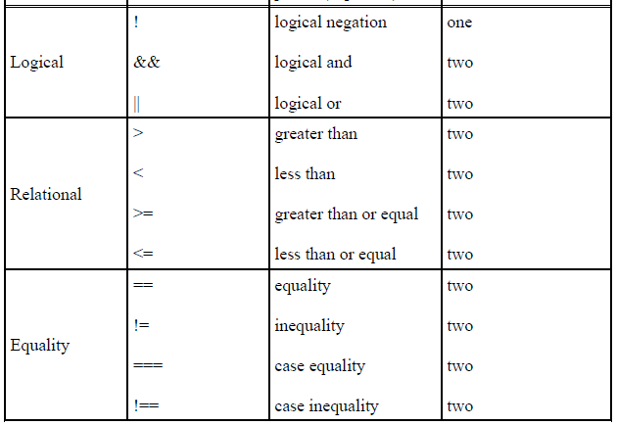
OPERATOR TYPES –Cont’d

Slide 18
Logical Operators
Logical operators are logical-and (&&), logical-or (||) and logical-not (!).
Operators && and || are binary operators. Operator ! is a unary operator.
Logical operators follow these conditions:
Logical operators always evaluate to a 1-bit value, 0 (false), 1 (true), or x(ambiguous).
2. If an operand is not equal to zero, it is equivalent to a logical 1 (true condition). If it is equal to zero, it is equivalent to a logical 0 (false condition).
If any operand bit is x or z, it is equivalent to x (ambiguous condition) and is normally treated by simulators as a false condition.
3. Logical operators take variables or expressions as operands.
NOTE: Use of parentheses to group logical operations is highly recommended to improve readability. Also, the user does not have to remember the precedence of operators.

Slide 19
Logical Operators
// Logical operations
A = 3; B = 0;
A && B // Evaluates to 0. Equivalent to (logical-1 && logical-0)
A || B // Evaluates to 1. Equivalent to (logical-1 || logical-0)
!A// Evaluates to 0. Equivalent to not(logical-1)
!B// Evaluates to 1. Equivalent to not(logical-0)
// Unknowns
A = 2'b0x; B = 2'b10;
A && B // Evaluates to x. Equivalent to (x && logical 1)
// Expressions
(a == 2) && (b == 3) // Evaluates to 1 if both a == 2 and b == 3 are
true.
// Evaluates to 0 if either is false.

Slide 20
Relational Operators
Relational operators are
greater-than (>)
less-than (<)
greater-than-or-equal-to (>=) and
less-than-or-equal-to (<=)
If relational operators are used in an expression, the expression returns a logical value of 1 if the expression is true and 0 if the expression is false
If there are any unknown or z bits in the operands, the expression takes a value x
These operators function exactly as the corresponding operators in the C programming language

Slide 21
Relational Operators
// A = 4, B = 3
// X = 4'b1010, Y = 4'b1101, Z = 4'b1xxx
A <= B // Evaluates to a logical 0
A > B // Evaluates to a logical 1
Y >= X // Evaluates to a logical 1
Y < Z // Evaluates to an x

Slide 22
Equality Operators
Equality operators are
logical equality (==),
logical inequality (!=),
case equality (===),
and case inequality (!==).
When used in an expression, equality operators return logical value 1 if true, 0 if false.
These operators compare the two operands bit by bit, with zero filling if the operands are of unequal length.

Slide 23
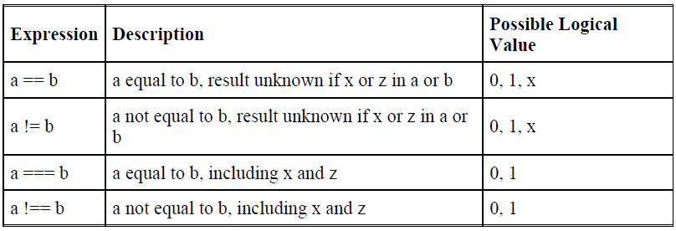
Equality Operators

Slide 24
Equality Operators
It is important to note the difference between the logical equality operators (==, !=) and case equality operators (===, !==).
The logical equality operators (==, !=) will yield an x if either operand has x or z in its bits.
However, the case equality operators ( ===, !== ) compare both operands bit by bit and compare all bits, including x and z.
The result is 1 if the operands match exactly, including x and z bits. The result is 0 if the operands do not match exactly.
Case equality operators never result in an x.
// A = 4, B = 3
// X = 4'b1010, Y = 4'b1101
// Z = 4'b1xxz, M = 4'b1xxz, N = 4'b1xxx
A == B // Results in logical 0
X != Y // Results in logical 1
X == Z // Results in x
Z === M // Results in logical 1 (all bits match, including x and z)
Z === N // Results in logical 0 (least significant bit does not match)
M !== N // Results in logical 1

Slide 25
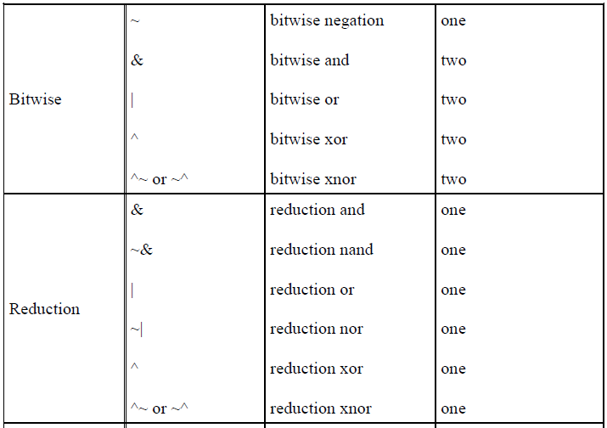
OPERATOR TYPES –Cont’d

Slide 26
Bitwise Operators
Bitwise operators are
negation (~)
and(&)
or (|)
xor (^)
xnor (^~, ~^)
Bitwise operators perform a bit-by-bit operation on two operands
They take each bit in one operand and perform the operation with the corresponding bit in the other operand
If one operand is shorter than the other, it will be bit-extended with zeros to match the length of the longer operand
A z is treated as an x in a bitwise operation
The exception is the unary negation operator (~), which takes only one operand and operates on the bits of the single operand

Slide 27
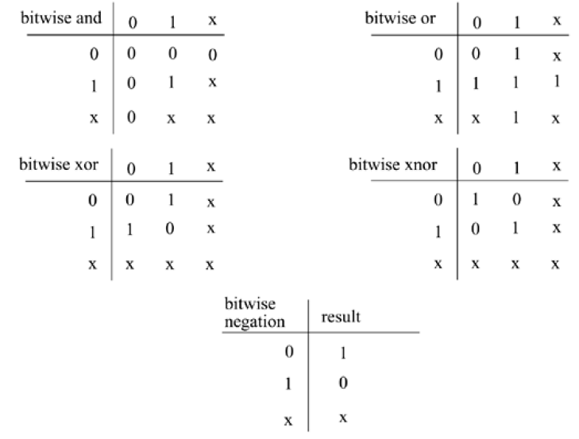
Bitwise Operators
Table 6-3. Truth Tables for Bitwise Operators

Slide 28
Bitwise Operators
Examples of bitwise operators are shown below.
// X = 4'b1010, Y = 4'b1101
// Z = 4'b10x1
~X // Negation. Result is 4'b0101
X & Y // Bitwise and. Result is 4'b1000
X | Y // Bitwise or. Result is 4'b1111
X ^ Y // Bitwise xor. Result is 4'b0111
X ^~ Y // Bitwise xnor. Result is 4'b1000
X & Z // Result is 4'b10x0
It is important to distinguish bitwise operators ~, &, and | from logical operators !, &&, ||.
Logical operators always yield a logical value 0, 1, x, whereas bitwise operators yield a
bit-by-bit value. Logical operators perform a logical operation, not a bit-by-bit operation.
// X = 4'b1010, Y = 4'b0000
X | Y // bitwise operation. Result is 4'b1010
X || Y // logical operation. Equivalent to 1 || 0. Result is 1.

Slide 29
Reduction Operators
Reduction operators are
and (&)
nand (~&)
or (|)
nor (~|)
xor (^), and
xnor (~^, ^~)
Reduction operators take only one operand. Reduction operators perform a bitwise operation on a single vector operand and yield a 1-bit result
The difference is that bitwise operations are on bits from two different operands, whereas reduction operations are on the bits of the same operand
Reduction operators work bit by bit from right to left

Slide 30
Reduction Operators
Reduction nand, reduction nor, and reduction xnor are computed by inverting the result of the reduction and, reduction or, and reduction xor, respectively.
// X = 4'b1010
&X //Equivalent to 1 & 0 & 1 & 0. Results in 1'b0
|X//Equivalent to 1 | 0 | 1 | 0. Results in 1'b1
^X//Equivalent to 1 ^ 0 ^ 1 ^ 0. Results in 1'b0
//A reduction xor or xnor can be used for even or odd parity
//generation of a vector.
The use of a similar set of symbols for logical (!, &&, ||), bitwise (~, &, |, ^), and
reduction operators (&, |, ^) is somewhat confusing initially. The difference lies in the
number of operands each operator takes and also the value of results computed.

Slide 31
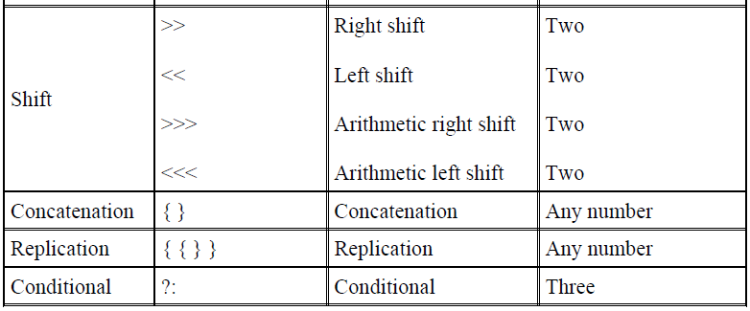
OPERATOR TYPES –Cont’d

Slide 32
Shift Operators
Shift operators are
right shift ( >>),
left shift (<<),
arithmetic right shift (>>>), and
arithmetic left shift (<<<).
Regular shift operators shift a vector operand to the right or the left by a specified number of bits.
The operands are the vector and the number of bits to shift. When the bits are shifted, the vacant bit positions are filled with zeros.
Shift operations do not wrap around.
Arithmetic shift operators use the context of the expression to determine the value with which to fill the vacated bits.

Slide 33
Shift Operators
// X = 4'b1100
Y = X >> 1; //Y is 4'b0110. Shift right 1 bit. 0 filled in MSB
position.
Y = X << 1; //Y is 4'b1000. Shift left 1 bit. 0 filled in LSB position.
Y = X << 2; //Y is 4'b0000. Shift left 2 bits.
integer a, b, c; //Signed data types
a = 0;
b = -10; // 00111...10110 binary
c = a + (b >>> 3); //Results in -2 decimal, due to arithmetic shift
Shift operators are useful because they allow the designer to model shift operations, shiftand-
add algorithms for multiplication, and other useful operations.

Slide 34
Concatenation Operator
The concatenation operator ( {, } ) provides a mechanism to append multiple operands.
The operands must be sized. Unsized operands are not allowed because the size of each operand must be known for computation of the size of the result.
Concatenations are expressed as operands within braces, with commas separating the operands.
Operands can be scalar nets or registers, vector nets or registers, bit-select, part-select, or sized constants.
// A = 1'b1, B = 2'b00, C = 2'b10, D = 3'b110
Y = {B , C} // Result Y is 4'b0010
Y = {A , B , C , D , 3'b001} // Result Y is 11'b10010110001
Y = {A , B[0], C[1]} // Result Y is 3'b101

Slide 35
Replication Operator
Repetitive concatenation of the same number can be expressed by using a replication constant.
A replication constant specifies how many times to replicate the number inside the brackets ( { } ).
reg A;
reg [1:0] B, C;
reg [2:0] D;
A = 1'b1; B = 2'b00; C = 2'b10; D = 3'b110;
Y = { 4{A} } // Result Y is 4'b1111
Y = { 4{A} , 2{B} } // Result Y is 8'b11110000
Y = { 4{A} , 2{B} , C } // Result Y is 8'b1111000010

Slide 36
Conditional Operator
The conditional operator(?:) takes three operands.
Usage: condition_expr ? true_expr : false_expr ;
The condition expression (condition_expr) is first evaluated.
If the result is true (logical 1), then the true_expr is evaluated. If the result is false (logical 0), then the false_expr is evaluated.
If the result is x (ambiguous), then both true_expr and false_expr are evaluated and their results are compared, bit by bit, to return for each bit position an x if the bits are different and the value of the bits if they are the same.
Alternately, it can be compared to the if-else expression.

Slide 37
Conditional Operator
Conditional operators are frequently used in dataflow modeling to model conditional assignments.
The conditional expression acts as a switching control.
//model functionality of a tristate buffer
assign addr_bus = drive_enable ? addr_out : 36'bz;
//model functionality of a 2-to-1 mux
assign out = control ? in1 : in0;
Conditional operations can be nested. Each true_expr or false_expr can itself be a conditional operation.
In the example that follows, convince yourself that (A==3) and
control are the two select signals of 4-to-1 multiplexer with n, m, y, x as the inputs and
out as the output signal.
assign out = (A == 3) ? ( control ? x : y ): ( control ? m : n) ;

